Slide 1

Weekly Progress
GE1.02 Shang-Wei Chang
2025/12/19

Slide 2
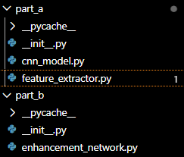
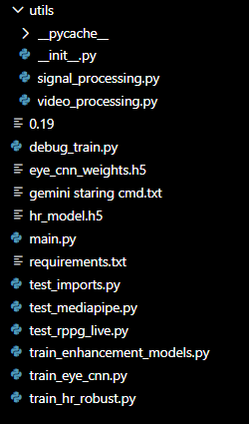
Last week, my progress is on train_eye_model.py
But I also encounter some issues with the hr_model for the data alignment.

Slide 3
This week I create train_hr_robust.py for the heart rate training.
Using UBFC-rPPG dataset, specifically DATA_1.

Slide 4
Content
Correct Ground Truth Utilization
Robust Data Handling & Memory Efficiency
Signal Preprocessing (Bandpass Filtering)
Enhanced Data Augmentation
Optimized Training Convergence
Key Improvements
Summary

Slide 5
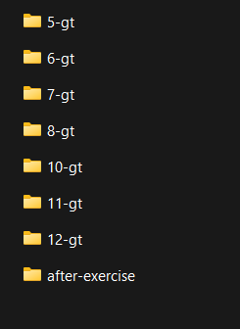

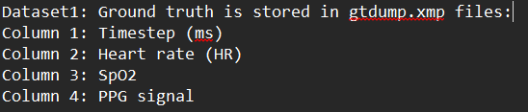
Correct Ground Truth Utilization
Instead of attempting to derive HR from PPG signal peaks (which was inaccurate, especially for short windows), the script now directly extracts the provided Heart Rate values from the gtdump.xmp files, leading to more accurate labels for training.

Slide 6
Robust Data Handling & Memory Efficiency
The training script processes video data one subject at a time, extracting features and then immediately releasing video frames from memory using gc.collect(). This prevents Out-Of-Memory (OOM) errors that were likely occurring during earlier full-dataset loading attempts.

Slide 7
Signal Preprocessing (Bandpass Filtering)
The extracted raw rPPG signal now undergoes a bandpass filter (0.7Hz to 4.0 Hz) using scipy.signal. This is crucial for rPPG as it removes low-frequency baseline drift (e.g., from breathing, head movement) and high-frequency noise, isolating the physiologically relevant heart rate components.

Slide 8
Enhanced Data Augmentation
To compensate for the small dataset (only 8 videos), the script now generates a significantly larger number of training samples by employing 90% overlap when creating sliding windows from the rPPG signals. This increased the effective dataset size from ~100 samples to ~664 samples, giving the model more data to learn from.

Slide 9
Optimized Training Convergence
Learning Rate Scheduler (`ReduceLROnPlateau`)
  dynamically reduces the learning rate during training if the validation loss stops improving
Early Stopping (`EarlyStopping`)
  monitors the validation loss and stops training early if no improvement is observed

Slide 10
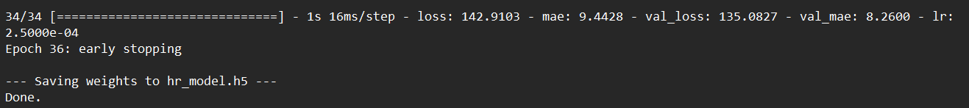
Key Improvements
Validation MAE (Mean Absolute Error):
  Drastically improved from an implied high value (likely > 20-30 BPM before improvements) to approximately 7.66 BPM.
  This means, on average, the model’s prediction error for heart rate is now within ~7-8 beats per minute of the actual value.
* Validation MSE (Mean Squared Error):
  Reduced significantly from potentially thousands to ~104.3.

Slide 11
Next Week
Finalize enhancement network, making sure the eye model and hr model is combined correctly
Start training the model on Vicomtech Driver Monitoring Dataset(DMD).

Slide 12
Thank you for listening
Q&A session

